Slide 1
ESMI Views
Module 3

Slide 2
Module Objectives
Upon completion of this module, you will be able to:
Recognize the BIG data problem.
Describe and identify the pitfalls associated with nonexistent logging standardization.
Describe and identify the problems associated with real time filtering with traditional log management and SIEM solutions.
Effectively navigate the McAfee ESMI Desktop.
Create custom SIEM data views to meet compliance and policy requirements.
Create custom SIEM data views to carry out security incident related investigations.

Slide 3

Module Topics
The Big Data Problem
Common Log Management Challenges
Content Aware Views
McAfee ESMI Desktop Components
McAfee Standard Views
Creating and Editing Custom Views
Data Binding

Slide 4
The Data Problem
Threats are Increasing in Numbers and Severity
Homogenous Networks no longer exist
Network Security Controls
Firewalls, IDS, and IPS
Traditional Network Monitoring
Behavior and Performance
Host-based controls
Local firewall/IDS, Access Controls
Logs
Email & Database Servers
Network Devices
Web Content Filtering
Anti-Malware Controls
Vulnerability Assessment Results
System Configuration Specs
Asset Inventory
Notes:
Today’s information security threats are not only increasing in numbers but in severity as well. The diversity of our networked environments are increasing exponentially as well. Most of us are very aware that homogenous environments no longer exist, and the complexity of the various technologies in our networks can get overwhelming. On top of that we are expected to understand how the different types of events within the environments can affect our security posture.

Slide 5

But there are more security incidents than ever!!!
WHY?
Notes:
With all that information being generated by all those nifty security technologies, controls, and devices why are there more incidents than ever?

Slide 6
Maybe because Log Data Looks like this!
nt-jfw1: NetScreen device_id=nt-jfw1 [Root]system-notification-00257(traffic): start_time="2012-03-25 22:37:46" duration=0 policy_id=320006 service=udp/port:24936 proto=17 src zone=Null dst zone=self action=Deny sent=0 rcvd=138 src=208.44.108.138 dst=69.43.137.10 src_port=53 dst_port=24936 session_id=0
nt-jfw1: NetScreen device_id=nt-jfw1 [Root]system-notification-00257(traffic): start_time="2012-03-25 22:37:46" duration=0 policy_id=320006 service=udp/port:24936 proto=17 src zone=Null dst zone=self action=Deny sent=0 rcvd=77 src=208.44.108.138 dst=69.43.137.10 src_port=53 dst_port=24936 session_id=0
nt-jfw1: NetScreen device_id=nt-jfw1 [Root]system-notification-00257(traffic): start_time="2012-03-25 22:37:46" duration=0 policy_id=320006 service=udp/port:24936 proto=17 src zone=Null dst zone=self action=Deny sent=0 rcvd=138 src=208.44.108.138 dst=69.43.137.10 src_port=53 dst_port=24936 session_id=0
nt-jfw1: NetScreen device_id=nt-jfw1 [Root]system-notification-00257(traffic): start_time="2012-03-25 22:37:47" duration=0 policy_id=151 service=tcp/port:445 proto=6 src zone=Untrust dst zone=External-LB action=Deny sent=0 rcvd=0 src=125.127.207.198 dst=69.43.137.37 src_port=2294 dst_port=445 session_id=0
SSG140-1: NetScreen device_id=SSG140-1 [Root]system-notification-00257(traffic): start_time="2012-03-25 22:37:08" duration=0 policy_id=5 service=Network Time proto=17 src zone=Trust dst zone=Untrust action=Deny sent=0 rcvd=0 src=192.168.1.218 dst=66.70.29.130 src_port=123 dst_port=123 session_id=0
Notes:
Who can make sense of this and gain a clear understanding of what is really happening on our networks?

Slide 7
And this!
ntExt: NetScreen device_id=ntExt system-critical-00436: ICMP packet too large has been detected! From 69.20.128.2 to 69.20.128.25, using protocol 1, and arriving at interface untrust in zone Untrust.The attack occurred 6 times. (2012-04-22 17:21:22)
ntExt: NetScreen device_id=ntExt system-notification-00257(traffic): start_time="2012-04-22 17:21:20" duration=4 policy_id=0 service=icmp proto=1 src zone=Trust dst zone=Untrust action=Permit sent=546 rcvd=546 src=69.20.0.10 dst=69.20.128.25 icmp type=8
ntExt: NetScreen device_id=ntExt system-notification-00257(traffic): start_time="2012-04-22 17:21:21" duration=3 policy_id=0 service=icmp proto=1 src zone=Trust dst zone=Untrust action=Permit sent=546 rcvd=546 src=69.20.0.10 dst=69.20.128.25 icmp type=8
ntExt: NetScreen device_id=ntExt system-critical-00436: ICMP packet too large has been detected! From 69.20.128.2 to 69.20.128.25, using protocol 1, and arriving at interface untrust in zone Untrust.The attack occurred 6 times. (2012-04-22 17:21:24)
ntExt: NetScreen device_id=ntExt system-notification-00257(traffic): start_time="2012-04-22 17:21:22" duration=4 policy_id=0 service=icmp proto=1 src zone=Trust dst zone=Untrust action=Permit sent=546 rcvd=546 src=69.20.0.10 dst=69.20.128.25 icmp type=8
ntExt: NetScreen device_id=ntExt system-notification-00257(traffic): start_time="2012-04-22 17:21:23" duration=3 policy_id=0 service=icmp proto=1 src zone=Trust dst zone=Untrust action=Permit sent=546 rcvd=546 src=69.20.0.10 dst=69.20.128.25 icmp type=8
ntExt: NetScreen device_id=ntExt system-critical-00436: ICMP packet too large has been detected! From 69.20.128.2 to 69.20.128.25, using protocol 1, and arriving at interface untrust in zone Untrust.The attack occurred 6 times. (2012-04-22 17:21:26)
Notes:
Who can make sense of this and gain a clear understanding of what is really happening on our networks?

Slide 8
And this!
IPENFORCER:CompName: IPE1 TIMESTAMP(GMT): Tue Jun 3 06:10:02 2012 CATEGORY: URL SEVERITY: MAJOR CUSTOMER_NAME: CUST1 SESSION_ID: 29460 SRC_IP: 192.168.2.170 DEST_IP: 80.80.3.71 SRC_PORT: 3721 DEST_PORT: 80 APPLICATION_NAME: HTTP URL_CATEGORY: Adult URL_NAME: www.penthouse.com CAUSE_STRING: URL Blocked
IPENFORCER:CompName: IPE1 TIMESTAMP(GMT): Tue Jun 3 06:10:02 2012 CATEGORY: URL SEVERITY: MAJOR CUSTOMER_NAME: CUST1 SESSION_ID: 29461 SRC_IP: 192.168.2.170 DEST_IP: 80.80.3.71 SRC_PORT: 3722 DEST_PORT: 80 APPLICATION_NAME: HTTP URL_CATEGORY: Adult URL_NAME: www.playboy.com CAUSE_STRING: URL Blocked
IPENFORCER:CompName: IPE1 TIMESTAMP(GMT): Tue Jun 3 06:10:02 2012 CATEGORY: URL SEVERITY: MAJOR CUSTOMER_NAME: CUST1 SESSION_ID: 29462 SRC_IP: 192.168.2.170 DEST_IP: 80.80.3.71 SRC_PORT: 3723 DEST_PORT: 80 APPLICATION_NAME: HTTP URL_CATEGORY: Search Engine URL_NAME: www.yahoo.com CAUSE_STRING: URL Blocked
IPENFORCER:CompName: IPE1 TIMESTAMP(GMT): Tue Jun 3 06:10:02 2012 CATEGORY: URL SEVERITY: MAJOR CUSTOMER_NAME: CUST1 SESSION_ID: 29464 SRC_IP: 192.168.2.170 DEST_IP: 80.80.3.71 SRC_PORT: 3724 DEST_PORT: 80 APPLICATION_NAME: HTTP URL_CATEGORY: Computing & Internet URL_NAME: www.cisco.com CAUSE_STRING: URL Blocked
IPENFORCER:CompName: IPE1 TIMESTAMP(GMT): Tue Jun 3 06:10:02 2012 CATEGORY: URL SEVERITY: MAJOR CUSTOMER_NAME: CUST1 SESSION_ID: 29465 SRC_IP: 192.168.2.170 DEST_IP: 80.80.3.71 SRC_PORT: 3725 DEST_PORT: 80 APPLICATION_NAME: HTTP URL_CATEGORY: Warez URL_NAME: www.kazaa.com CAUSE_STRING: URL Blocked
Notes:
Who can make sense of this and gain a clear understanding of what is really happening on our networks?

Slide 9
And this!
06/15/2012 9:32:43~SQLserver~System~Information~7035~None~NT AUTHORITY\SYSTEM~Service Control Manager~The ESA LEA Service service was successfully sent a stop control.
06/15/2012 9:32:43~SQLserver~System~Information~7036~None~-~Service Control Manager~The ESA LEA Service service entered the stopped state.
06/15/2012 9:32:44~SQLserver~System~Information~7036~None~-~Service Control Manager~The ESA LEA Service service entered the running state.
06/15/2012 9:32:44~SQLserver~System~Information~7035~None~NT AUTHORITY\SYSTEM~Service Control Manager~The ESA LEA Service service was successfully sent a start control.
06/15/2012 9:33:4~SQLserver~System~Error~10009~None~NT AUTHORITY\SYSTEM~DCOM~DCOM was unable to communicate with the computer 192.168.80.103 using any of the configured protocols.
06/15/2012 9:33:25~SQLserver~System~Error~10009~None~NT AUTHORITY\SYSTEM~DCOM~DCOM was unable to communicate with the computer 192.168.80.103 using any of the configured protocols.
06/15/2012 9:33:54~SQLserver~System~Error~10009~None~NT AUTHORITY\SYSTEM~DCOM~DCOM was unable to communicate with the computer 192.168.80.103 using any of the configured protocols.
06/15/2012 9:34:14~SQLserver~System~Information~7035~None~NT AUTHORITY\SYSTEM~Service Control Manager~The ESA LEA Service service was successfully sent a stop control.
06/15/2012 9:34:14~SQLserver~System~Information~7036~None~-~Service Control Manager~The ESA LEA Service service entered the stopped state.
06/15/2012 9:34:15~SQLserver~System~Information~7035~None~NT AUTHORITY\SYSTEM~Service Control Manager~The ESA LEA Service service was successfully sent a start control.
Notes:
Who can make sense of this and gain a clear understanding of what is really happening on our networks?

Slide 10
And this!
nDevice Date=|2010-05-14|, Time=|13:19:04|, Time-Taken=|184|, Source=|69.20.10.101|, Status=|302|, Action=|TCP_NC_MISS|, IncomingBytes=|544|, OutgoingBytes=|1023|, Method=|GET|, Scheme=|http|, Username=|sammy|, Supplier=|go.microsoft.com|, UserAgent=|Windows-RSS-Platform/1.0 (MSIE 7.0; Windows NT 5.1)|, Result=|OBSERVED|, Category=|Computers/Internet|, Virus=|-|, DeviceIP=|69.20.14.11|, DevicePort=|8080|, URL=|http://go.microsoft.com/fwlink/?LinkId=68929|, DestinationIP=|207.46.16.233|, DestinationPort=|80|
nDevice Date=|2010-05-14|, Time=|13:19:04|, Time-Taken=|46|, Source=|69.20.10.101|, Status=|200|, Action=|TCP_NC_MISS|, IncomingBytes=|667|, OutgoingBytes=|759|, Method=|GET|, Scheme=|http|, Username=|sammy|, Supplier=|www.microsoft.com|, UserAgent=|Windows-RSS-Platform/1.0 (MSIE 7.0; Windows NT 5.1)|, Result=|OBSERVED|, Category=|Computers/Internet|, Virus=|-|, DeviceIP=|69.20.14.11|, DevicePort=|8080|, URL=|http://www.microsoft.com/atwork/community/rss.xml|, DestinationIP=|207.46.19.254|, DestinationPort=|80|
nDevice DatDeviceIP=|69.20.14.11|, DevicePort=|8080|, URL=|http://www.tanea.gr/templates/default/flashobject.js|, DestinationIP=|208.19.38.8|, DestinationPort=|80|e=|2010-05-14|, Time=|13:34:07|, Time-Taken=|184|, Source=|69.20.10.101|, Status=|302|, Action=|TCP_NC_MISS|, IncomingBytes=|544|, OutgoingBytes=|1023|, Method=|GET|, Scheme=|http|, Username=|sammy|, Supplier=|go.microsoft.com|, UserAgent=|Windows-RSS-Platform/1.0 (MSIE 7.0; Windows NT 5.1)|, Result=|OBSERVED|, Category=|Computers/Internet|, Virus=|-|, DeviceIP=|69.20.14.11|, DevicePort=|8080|, URL=|http://go.microsoft.com/fwlink/?LinkId=68929|, DestinationIP=|207.46.16.233|, DestinationPort=|80|
Notes:
Who can make sense of this and gain a clear understanding of what is really happening on our networks?

Slide 11
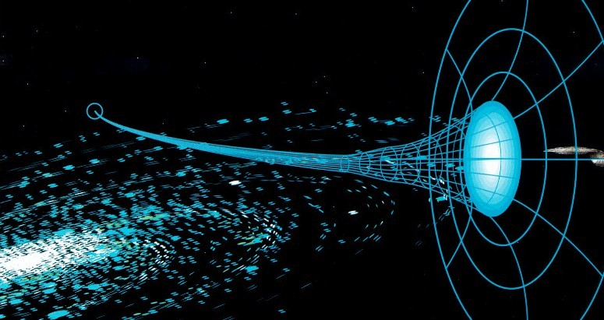
No Standardization!
Common Log Data Issues:
No Common Format
No Standardization
Some Data Sources Log more Verbose then others
Notes:
Logging standardization is nonexistent and compares to entering a worm hole for which we have no idea what is going to come out the other side!

Slide 12

Lots and Lots of Data!
Volumes of Data:
A Typical Firewall in a SMB Infrastructure generates 100k+ Events Daily
Enterprise Firewalls generate data in the Millions!
Work Station or End User Host: ~5k Events Daily (Audit Settings Matter here)
100 Hosts: 5,000 * 100 = 500,000 Events Daily
1,000 Hosts: 5,000 * 1,000 = 5,000,0000 Events Daily
Notes:
These security technologies generate volumes of data that can be extremely overwhelming to say the least.

Slide 13
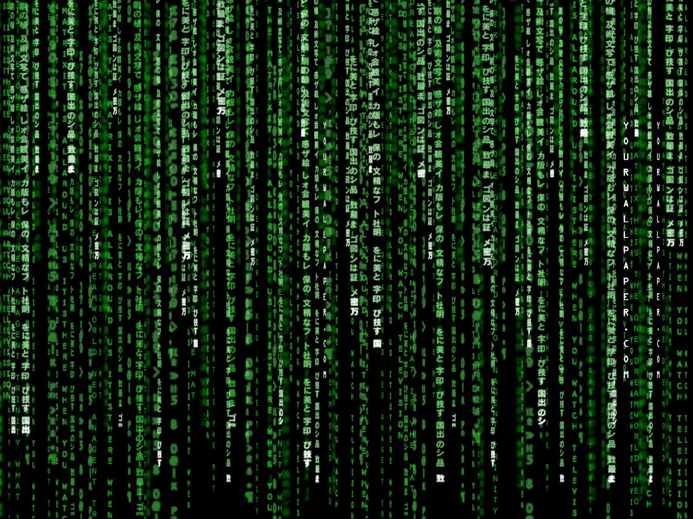
A Visual Dilemma!
Real Time Streaming and No Standardization:
Lots of Data at High Volumes tends to look a lot like this:
Notes:
With those high volumes and no log standardization combined with security requirements we tend to believe real time streaming of all this data will help us, but will it really?

Slide 14
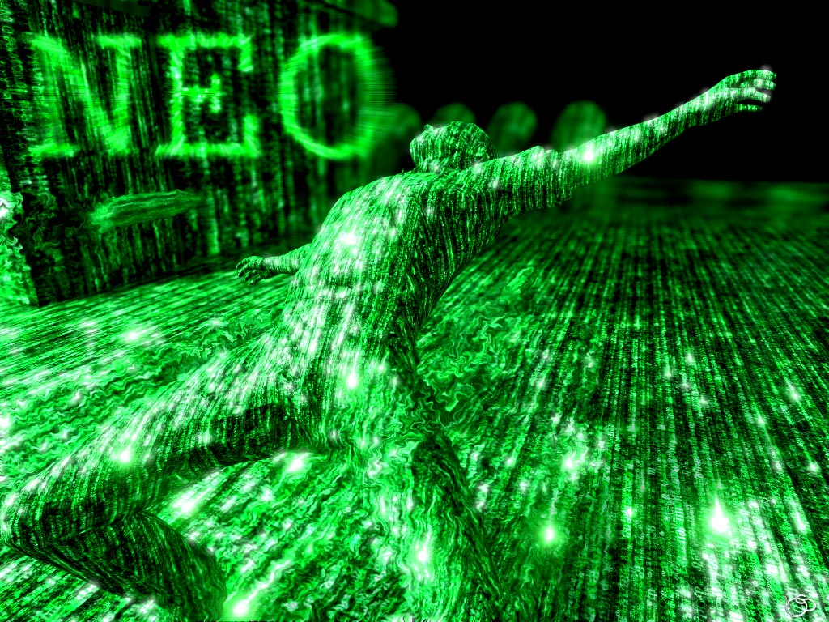
It works for NEO!
Notes:
In the Matrix, Neo was able to become one with the machine, but in real life we are not afforded this possibility.

Slide 15
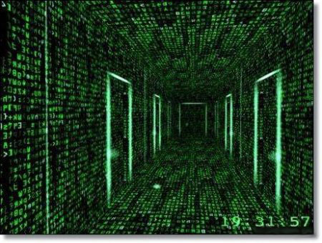
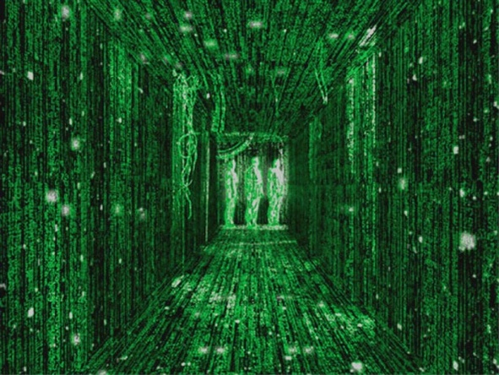
Doesn’t Work Well For Us!
Real Time Streaming and No Standardization (Traditional Log Management):
But we can filter it… Right?
Filter on What:
Remember No Logging Standardization
Event Details are different depending on Data Source
Do you really know in Real Time what your looking for as it is HAPPENING?
Filter for “BADNESS”?
Filtering does work for TROUBLESHOOTING
Notes:
Many will make the case that filtering will allow a log management technology to become useful but does it really work. How do we create a filter for something that has no format standardization? How do we filter for “badness” in real time, as what is considered bad? If we knew what badness was, wouldn’t we just block badness in the first place?

Slide 16
Log Management Challenges
According to the SANS Seventh Annual Log Management Survey Report (http://www.sans.org/reading_room/analysts_program/logmgt-survey-web.pdf):
Normalizing and Categorizing Information
Searching
Using logs for reporting and analysis
Managing logs, including maintaining chain of custody
Using logs for compliance
Storing/archiving
Collecting logs
Using logs for operations and maintenance
Some Key Thoughts and Observations:
Searching complications are a result of not Normalizing and Categorizing Information
Log Management tends to lend itself more to data you can take action on Versus producing Actionable Data Intelligence
Notes:
The log management challenges are clearly documented in the Seventh Annual Log Management Survey Report by SANS. These challenges are in the following areas:
Normalizing and Categorizing Information
Searching
Using logs for reporting and analysis
Managing logs, including maintaining chain of custody
Using logs for compliance
Storing/archiving
Collecting logs
Using logs for operations and maintenance

Slide 17
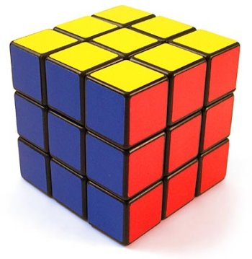

The Solution!
McAfee SIEM solves this with VIEWS!

Slide 18
Content Aware SIEM Views
Theft of Confidential Information
Drilling Down to what is IMPORTANT
Use of Unauthorized applications
Cyber slacking in the workplace
Use of weak passwords

Slide 19
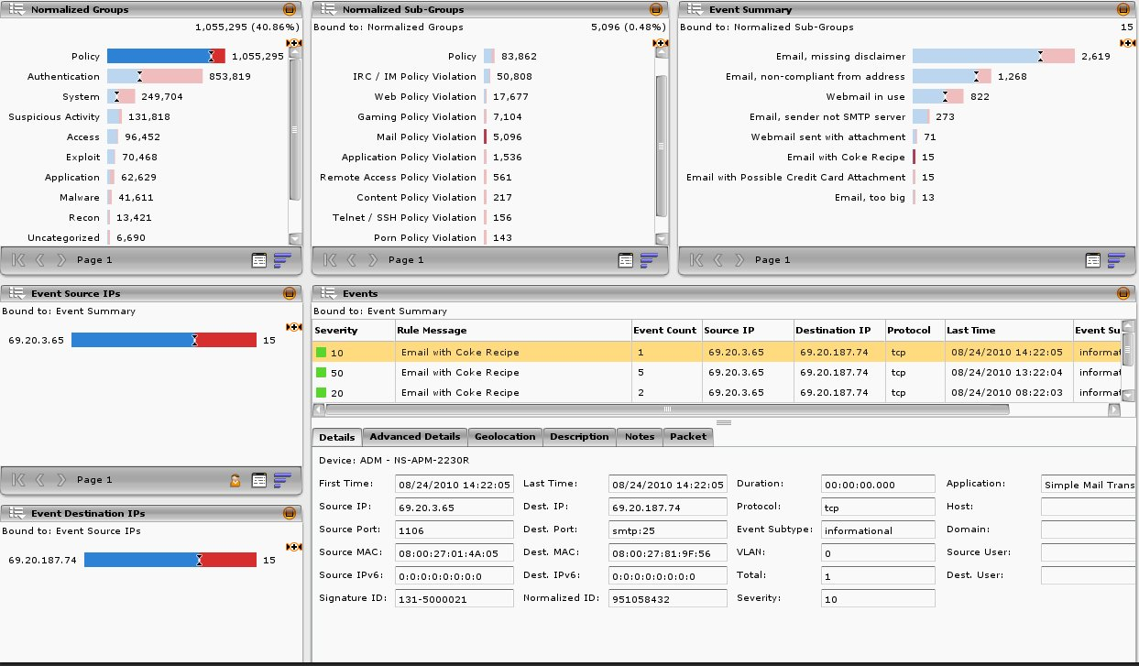
Theft of Confidential Information
1 Million+
5,000+
15
Normalized Dashboard
View
Notes:
The McAfee ESMI desktop allows you to in a single pane drill down from 1 Million+ events into what is important in just a few seconds and without having to create filters to fully re-query the database. Normalization is also extremely important, as events are placed in categories allowing us to drill into the areas that are most concerning to us at the time.

Slide 20
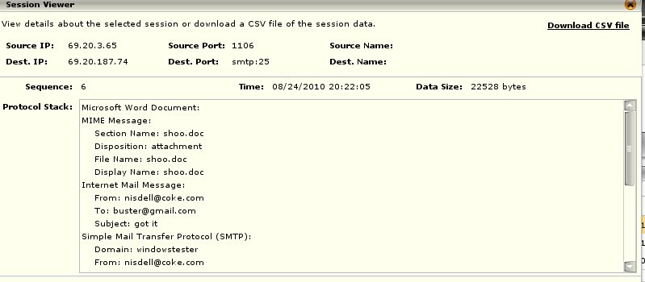
Theft of Confidential Information
Advanced Details
File Size
Document Type
Document Information
Subject
Email From
Email To
Domain
Notes:
Adding in Content Awareness with the McAfee ESMI drill down and Normalization capabilities ensures that within that single pane we can also render the event details in a clear and concise format. This all occurs in just a few seconds, as opposed to manually trying to extract this information from a traditional log management solution and then having to parse the log lines to figure out what exactly occurred and who was involved.

Slide 21
Content Aware SIEM Use Cases
Theft of Confidential Information
Use of Unauthorized applications
Situational Awareness
Cyber slacking in the workplace
Use of weak passwords

Slide 22
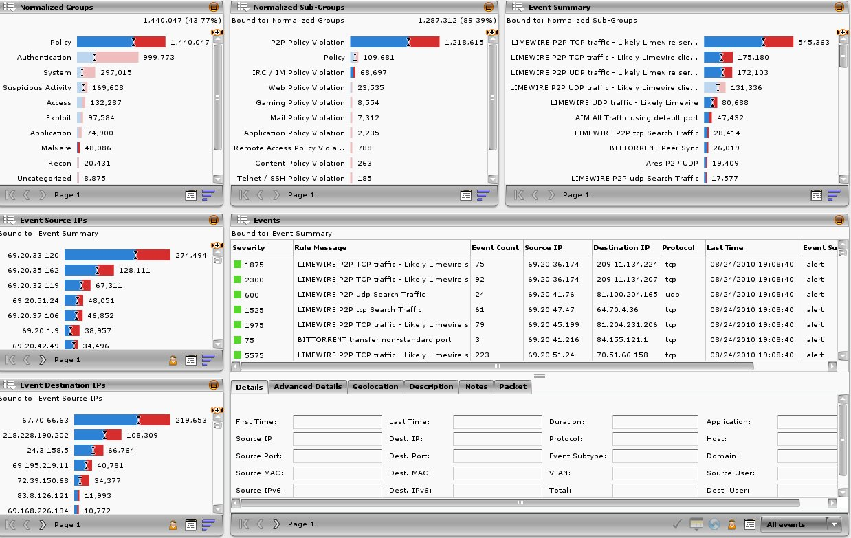
Use of Unauthorized Applications
Notes:
The overall picture of what is occurring in environments is just as important as being able to drill into individual events. In traditional log management solutions and even other SIEM technologies the big picture is missing in that the event information is presented in a table format. How can an analyst get the bigger picture by looking at spreadsheet formatted tables with rows and rows of events? Adding in the base lining capabilities of the McAfee SIEM an analyst doesn’t just get the big picture but also how the big picture has changed over time. It really is that simple in that the big picture is the definition of “Situational Awareness”.

Slide 23
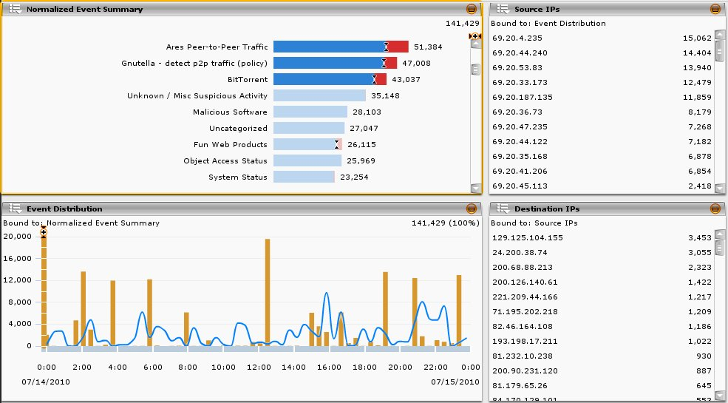
Use of Unauthorized Applications
P2P Applications Peak Usage Lunch and After Hours
P2P Applications
Lunch
After Hours
After Hours
Notes:
Situational awareness through base-lining and trending is key to understanding our environments. How would an analyst go about trending this data from raw log lines in a log management solution or a traditional SIEM user interface that presented hundreds of thousands of lines of events?

Slide 24
Content Aware SIEM Use Cases
Theft of Confidential Information
Use of Unauthorized applications
Cyber slacking in the workplace
Usage and Policy Awareness
Use of weak passwords

Slide 25
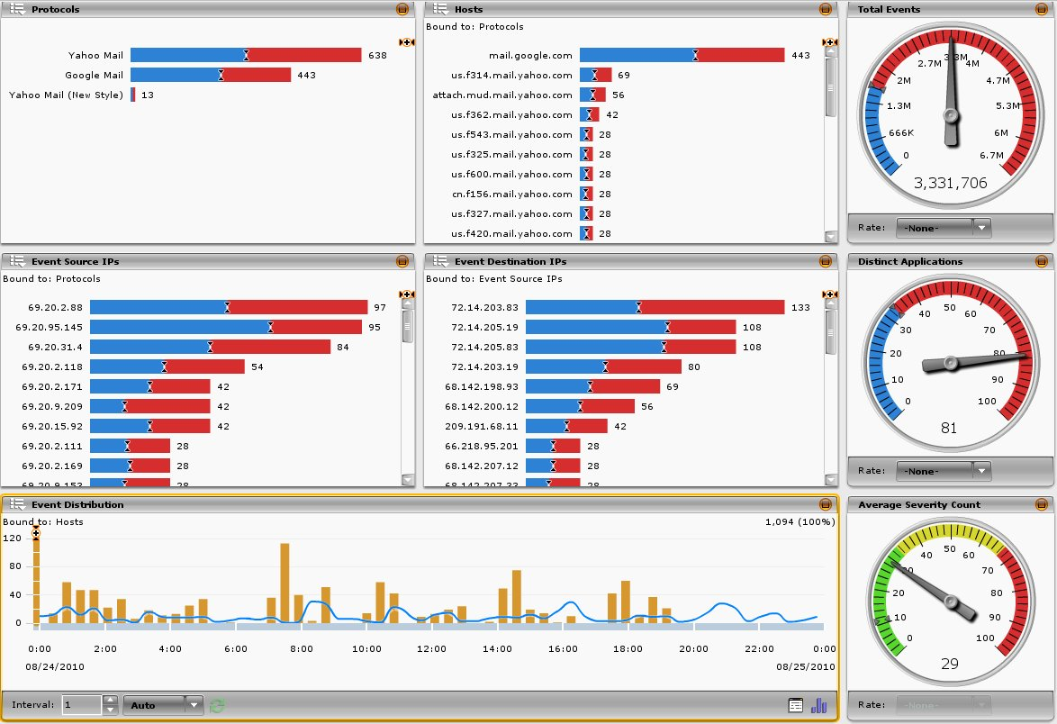
Cyber slacking in the workplace
Notes:
Monitoring our environments for policy violations and usage is a basic requirement for most of us. We want to know what makes up the traffic flowing across our networks.

Slide 26
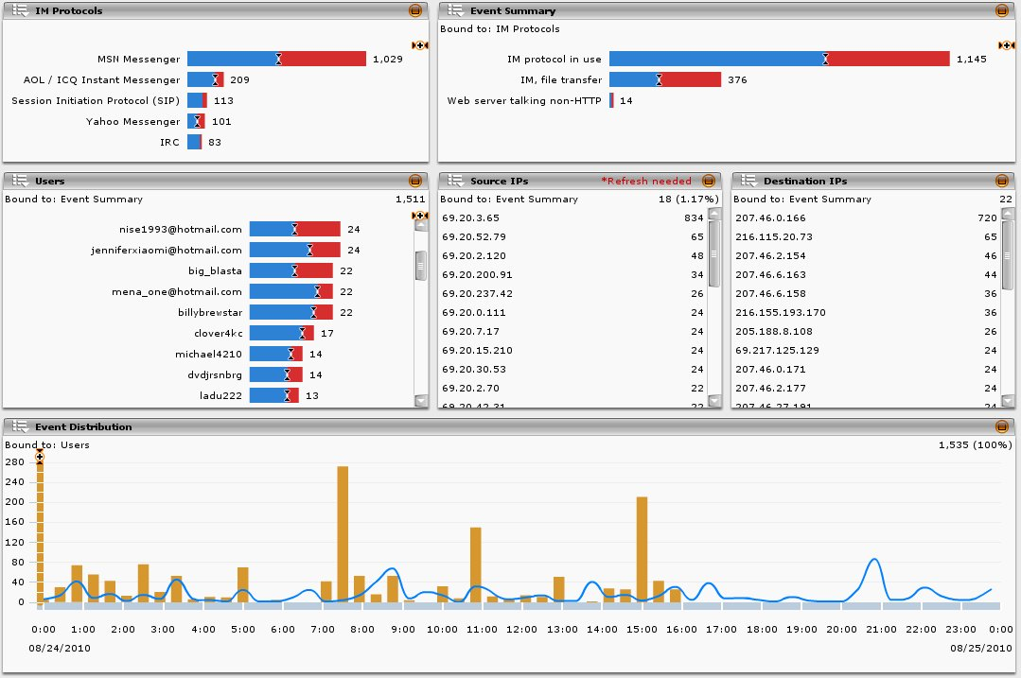
Cyber slacking - Instant Messaging Summary
Notes:
With McAfee’s ESMI Desktop and application awareness we can quickly gather what users from what locations are accessing what services.

Slide 27
Content Aware SIEM Use Cases
Theft of Confidential Information
Use of Unauthorized applications
Cyber slacking in the workplace
Use of weak passwords
Compliance Visibility

Slide 28
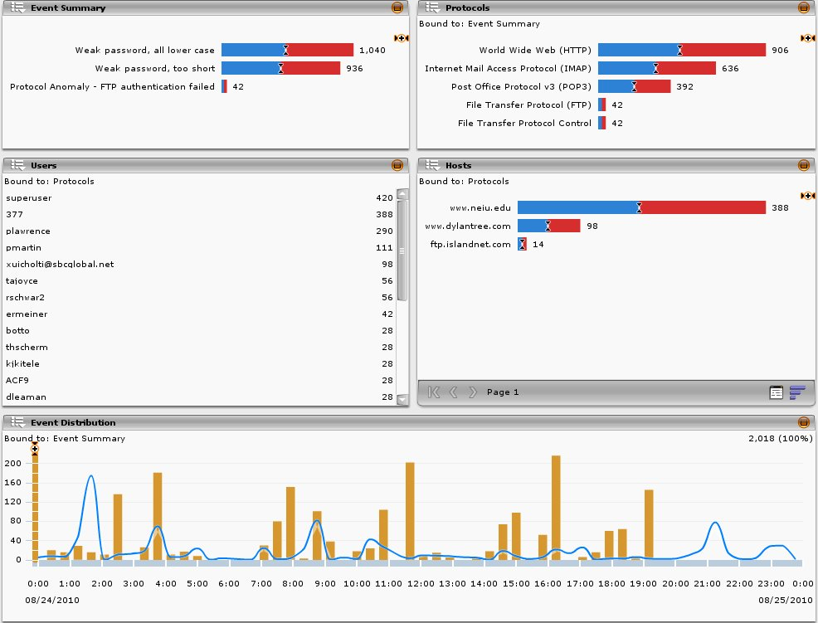
Use of Weak Passwords
Notes:
Compliance is one of those checkboxes we all have to face and well it never seems easy to provide the auditor with exactly what they want to see but with McAfee’s ESMI desktop that is no longer a problem. Does you auditor want to know if anyone is using weak or insecure passwords, well in just a few clicks of the mouse and a few seconds you can give the auditor what they want. How awesome is that?

Slide 29
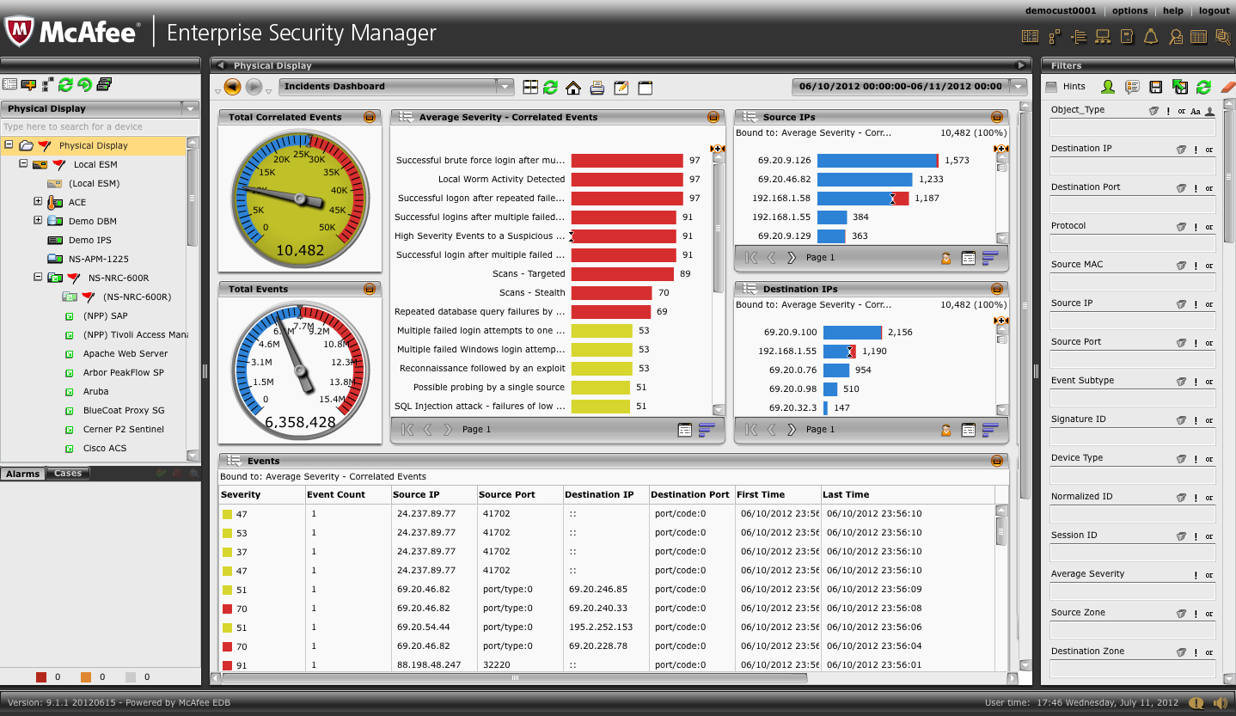
McAfee User Interface
Quick Launch
Views Toolbar
Time Frame
System Navigation
Filters
ESMI Desktop (Views Pane)
Alarms
&
Cases
Notes:
The McAfee ESM retrieves information about events, flows, and assets and vulnerabilities logged by a device. This information, for events, includes fields such as first and last time, event aggregation count, source and destination IP, source and destination port, source and destination MAC address, protocol, VLAN, the action taken when the alert was generated, and the signature ID of the rule generating the alert. For flows, this information includes first and last time, source and destination IP, source and destination port, source and destination MAC address, protocol, VLAN, direction, and the number of bytes and packets transmitted by the source and destination, respectively.
This information retrieved from a device is correlated and inserted into the McAfee Security Event Aggregation and Correlation (M-SEAC) engine. Using the M-SEAC engine, this data can be analyzed and reviewed through a powerful and flexible report viewer. This viewer is the center section of the ESMI Desktop.
Views Pain - The large main area to the right of the System Navigation Tree on the ESMI Desktop. It allows you to select, view, and customize views.
Views Toolbar – Allows you to access the various options associated with using Views.
Time Frame – Allows you to specify the time frame for the information that you want to view.
Quick Launch – Shortcuts to the most common features of the McAfee SIEM Solution.
Filters – Provides the ability to customize the query filters that are applied to the views at runtime.
System Navigation – Provides the ability to navigate by systems and devices.
Alarms & Cases – Shortcuts to the most recent cases and alarms.

Slide 30
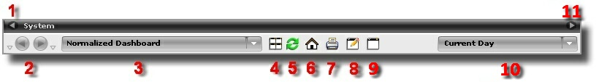
Views Toolbar
Hide Device Tree
View Navigation
View List
Manage Views
Refresh Current View
Default View
Print Current View
Edit Current View
Create a New View
Time Frame
Hide Filters/Show Filters
Notes:
The Views Toolbar contains the following options.
Hide Device Tree - The Hide Device Tree arrow allows you to expand the current view by hiding the device tree pane.
View Navigation - The View Navigation arrows allow you to navigate back and forth to previously viewed pages.
View List - The list of views allows you to select the information you wish to view for each device. To change the view, click on the down arrow and select the desired view.
Manage Views - The Manage Views dialog is a quick way for you to manage all views. It allows you to select which views appear in the views list. From the manage views dialog you also have the options to edit, rename, set the default, delete, import, and export views.
Refresh Current View - The Refresh Current View button refreshes all data that is currently displayed in the View pane.
Default View - This icon will take you back to the default view.
Print Current View - The Print Current View option allows you to print a hard copy of the current view. When you select this option, the Print Options dialog opens. Select one of the available options on the dialog then click OK. The print options are:
Scale to fit all components on one page: The components that are part of the view will be sized so the view will fit on one page.
Print each component on a separate page: Each component that is part of the view will be printed on a separate page. If you click on Scale component to fit page, each component will be sized to fill the page.
Print viewable area only: Only the portion of the view that is visible on the screen will be printed.
Export to PDF: The view will be saved as a PDF file.
Continued on next page

Slide 31
Hidden
Notes:
Edit Current View - The Edit Current View option allows you to modify the view currently being displayed, if it is a custom view. Clicking on this option will open the View Editor
Create a New View - Create a New View allows you to create a new custom view
Time Frame - The Time Frame drop-down list allows you to specify the time frame for the information that you wish to view
Hide Filters/Show Filters - The Hide Filters/Show Filters arrow allows you to expand the current view by hiding the filters pane or showing the filters pane if it is hidden.

Slide 32
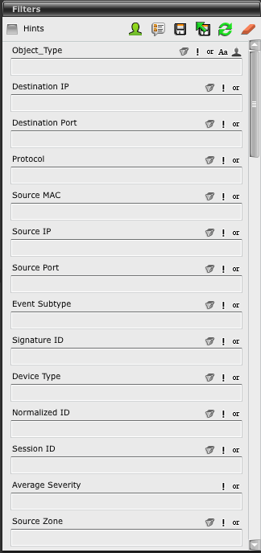
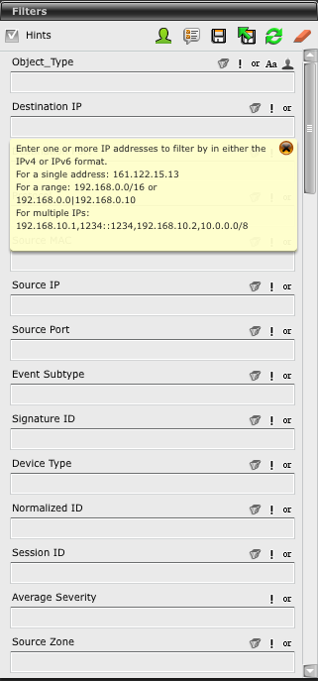
Filters
Hints
String Normalization
Add or Remove Filter Options
Save Current Values as Default
Use Default
Run Query
Clear All
NOTE
To help you be aware of when filters are applied to the view, an orange funnel icon will appear in the main View Pane top bar.
Notes:
The filters pane (right side of the ESMI desktop) allows you to specify the filtering to be applied to an event-based or flow-based view associated with a query notification. Filters are selected based on the type of view you want to generate. The Filters Toolbar gives you the option to add or remove filter options, save the values as the default, use the default, run the query, and clear all of the filter fields. Additionally, there is a Hints checkbox which, when selected, will enable a hint tool tip to be visible when a filter field has focus. This tool tip contains examples of the values that can be entered in the field.
Hints - When the Hints checkbox is selected, a tool tip will be visible when a filter field has focus. The tool tip contains examples of the values that can be entered in that field. A pop-up menu appears below the field, citing examples of values that need to be entered. The hint option is turned off by default.
String Normalization – The string normalization feature allows you to set up a string value that can be associated with alias values, to import a .CSV file of string normalization values, or to export a file.
Add or remove filter options - This option allows you to select the filter options you wish to display. To do so, click on the Add and remove filter options icon and the Displayed Filters dialog will appear. The filters that are checked will be displayed on the view filter list. To change the order in which they will appear on the list, highlight the filter and click on the up or down arrow located to the right of the list. If you have added any custom types, they will be displayed on the view filter list.
Save current values as default - To save a filter as your default, enter the values that you wish to use and click the Save current values as default icon. This will save your filters to the ESM. These filters will be applied automatically when you log in. To remove all values from your default filter, clear all the fields, re-execute the query, and click Save current values as default.
Use default - You can revert to your default filter value at any time during your session by clicking on the Use default icon.
Continued on next page

Slide 33
Hidden
Notes:
Run Query - The Run Query icon causes the current filters in the dialog to be applied to the view. You must click this icon when you change a filter value and want to apply it to the current view.
Clear All - To clear all filters, click the Clear All icon. This will clear all filters from the dialog. You must click the Run Query icon to refresh the view. When filters have been applied an orange funnel icon will appear. If clicked, all filters will be cleared and the query will be re-executed.

Slide 34
Out-of-Box Views
ADM Views - Focus on ADM activities, protocol, and authentication.
Compliance Views - Assist in streamlining regulation compliance activities.
Dashboard Views - Provide a quick overview of specific aspects of the system.
Database Views - Focus on database activity, security, compliance, performance, and operations.
Event Views - Break down the information generated by events associated with the device selected in the System Navigation Tree.
Executive Views - Provide an overview of aspects of the system that are of most interested to non-IT employees.
Flow Views - Break down the information recorded about each flow.
McAfee Event Reporter - Includes product-specific views for McAfee products.
Risk Views - These views are designed to be used with the ACE default manager.
Device Status view - Shows the status of the device(s) selected on the System Navigation Tree.
Enhanced ELM Search view - Enhances ELM searching capabilities by providing you with real-time tracking of the search progress and results.
Triggered Alarms view - Lists all of the alarm that have been triggered when an alarm condition(s) has been met.
Notes:
For a list of all the available out-of-box views, drill down through the View List menu.

Slide 35








Custom Views
Control Dial - Dashboard dials represent a simpler way to show important network, asset, vulnerability, and event data at a glance
Source and Destination Graph - Displays an overview of activity for one or more IP Addresses in a flow graph
Pie Chart - Displays the queried information in a pie graph
Table - Displays the selected query information in a table format
Bar Chart - Displays the queried information in a bar graph and allows you compare the size of each result of the query criteria for the selected device or group in a given time range
List - Displays the selected query data in a list format and is useful when you want to view a more detailed list of items in a smaller space
Distribution - Shows a distribution of events and flows over a period of time
Notes:
The View Editing Toolbar allows you to save your current view, save the current view with a new name, copy the current view, paste a component in a view or manage the view list, delete the current view, and click and drag view components (Source and Destination Graph, Pie Chart, Table, Bar Chart, List component, etc.) from the Toolbar to the Main View Pane.
Control Dial - The Control Dial component enhances the visual look of a view. These "Dashboard" dials represent a simpler way to show important network, asset, vulnerability, and event data at a glance. Unlike dials in other SIEM dashboards, these dials are dynamic, and may be "linked" to other components in the console, so that they update in relation to your interaction with the ESMI.
Source and Destination Graph - A Source and Destination Graph displays an overview of activity for one or more IP Addresses. This graph allows you to display event or flow data. The event option allows you to specify one or more IP address(es) and view all attacks that have been performed the specified IP address(es), as well as view all attacks that the specified IP address(es) has performed on other IP addresses. The flow option allows you to specify one or more IP address(es) and view that IP address(es) that have connected to the specified address(es), as well as view the connections that the IP address(es) has made connections to.
Pie Chart - A Pie Chart displays the queried information in a pie graph. This component is useful when you have fewer categories that you would like to view (e.g., a protocol or action query). The Pie Chart has a three-way toggle option in the bottom right corner. This allows you to toggle the chart type between pie, line, and area.
Table - A Table component displays the selected query information in a table format, which displays several columns of information regarding the query. This component is useful if you want to show event and flow data at its finest granularity. Each row of the table represents one record in the database.
Continued on next page

Slide 36
Hidden
Notes:
Bar Chart - A Bar Chart displays the queried information in a bar graph and allows you compare the size of each result of the query criteria for the selected device or group in a given time range. The Bar Chart has a three-way toggle option in the bottom right corner. This allows you to toggle the chart type between bar, line, and area.
List - A List component displays the selected query data in a list format. This component is useful when you want to view a more detailed list of items in a smaller space. The List component has a three-way toggle option in the bottom right corner. This allows you to toggle the chart type between list, line, and area.
Distribution - This component shows a distribution of events and flows over a period of time. The Distribution component has a three-way toggle option in the bottom right corner. This allows you to toggle the chart type between distribution, line, and area. You can also set intervals to look at specific time slices to shape the data.

Slide 37






Custom Views
Note Area - A blank component that is used for text-based notes
Count Component - Displays the total events, assets, vulnerabilities, or flows queried for a specific view
Title Component - Allows you to create a title or heading for a view
Network Topology - Allows you to obtain event or flow data from the device(s) or device tree and view the data represented across the network
Geolocation Map - Shows the destination and source location of alerts and flows on a Geolocation map
Filter List - Allows you to set up a view component that will display a list of the users and groups in your Active Directory
Notes:
Note Area - The Note Area component is a blank component that is used for text-based notes. This component allows you to write notes that are related to the current view. The text is only editable in the View Editor.
Count Component - The Count component displays the total events, assets, vulnerabilities, or flows queried for a specific view.
Title Component - The Title component allows you to create a title or heading for your view. When you click on the Title component icon and drag it on to the main view pane, a box appears. Click inside the box and a cursor will appear enabling you to type and format your text. The Title component can be placed anywhere on your view by clicking on the box and dragging it to the desired location.
Network Topology - Network Topology allows you to obtain event or flow data from the device(s) or device tree and view the data represented across the network. It also allows you to custom build a view which can be used hand in hand with network discovery data.
Geolocation Map - This component shows the destination and source location of alerts and flows on a Geolocation map. Options at the bottom of this component allow you to switch between marking City, State, Country, and World areas, zoom in and out, and select locations using the Ctrl and Shift keys.
Filter List - You can set up your ESM to retrieve Active Directory group and user data. The Filter List option on the View Editing Toolbar allows you to set up a view component that will display a list of the users and groups in your Active Directory. Once the Filter List component has been added, other components can be bound to it by clicking on the down arrow in the Source User or Destination User filter fields on the Query Wizard and selecting Bind to Active Directory List. In addition, you can drill down on the Filter List component to view event and flow data associated with the Active Directory by clicking on the menu icon.

Slide 38
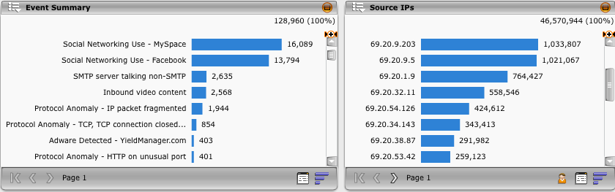
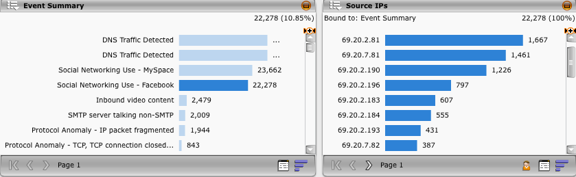
Data Binding
Allows you to bind one component to another
Who is using Facebook?
Notes:
Data binding in a custom view allows you to bind one component to another, so that the selection in one component provides a filter for a bound component. This allows you to set up an automatic drill down within a view that can be easily accessed from the initial component.

Slide 39
Logging standards clearly define the format and verbosity application developers should output logs in?
True
False
Notes:
Answer:
False: Logging standards are nonexistent.

Slide 40
When a “filter” has been actively applied to the McAfee ESMI Desktop what visual indication is provided?
A green funnel
A orange funnel
The view pane is highlighted in orange
The view pane is highlighted in green
A “Filtered” message is shown in the view pane
Notes:
Answer:
A orange funnel: To help you be aware of when filters are applied to the view, an orange funnel icon will appear in the main View Pane top bar.

Slide 41
Which of the following icons will create a source and destination graph component?
1.
2.
3.
4.
5.
Notes:
Answer:
3. Source and Destination Graph - Displays an overview of activity for one or more IP Addresses in a flow graph

Slide 42
Hands-on Practice Refer to the Practice Manual Practice 3: Creating a Custom View

